Slide 1

A Web Project By
Jigar Patel (10364229)
Tanmay Salunkhe (10364706)
Tipson Samuel (10362569)
GROUP 7

Slide 2
QUICK QUIZ 10364229.000webhostapp.com
WELCOME TO QUIZ WORLD

Slide 3

Quiz model using html5, css, javascript, Jquery

Slide 4
introduction
Quick Quiz is a Quiz Web Application which depicts the quiz model.
Our Quiz Application has questions from mainly 4 categories :
Cars
PS Gaming
iPhone
Technology
And Each category has separate scoring system. Once all the answers are marked and submitted, user gets the message indicating the score for that category.

Slide 5

HTML5
Used basic HTML5 Tags
Used radio button for options
Used Navigation bar for navigating to various categories

Slide 6

CSS and styling
We are using CSS3 for styling purpose
With the help of media queries in CSS we are making the web page size compatible to various device screen sizes

Slide 7

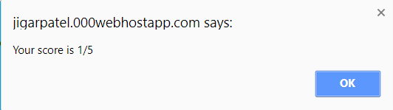
JAVASCRIPT
JavaScript is used for the calculating the score of the each category using the score() function
We have also used JavaScript to make the web pages responsive

Slide 8

api
We have two APIs:
Device Orientation – It helps to orient the web pages screen with respect to mobile position
Web Storage – Here we have used LocalStorage API for storing the username and password of the user and validate the same during login.

Slide 9
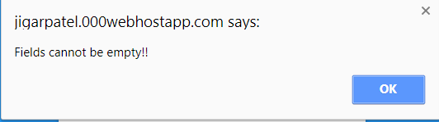
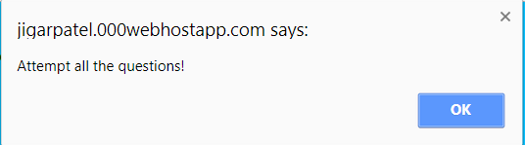
Validations using JavaScript
We have made the JavaScript user validation for the registration and login form
We have used regular expressions to validate the email id and password in registration form
We have also used the JavaScript for validating the quiz page radio buttons if they are all selected in each category

Slide 10
Working of the application
Home Page Quiz Category
About Us Play
Contact Us Gives Score
Login/Registration Logout

Slide 11
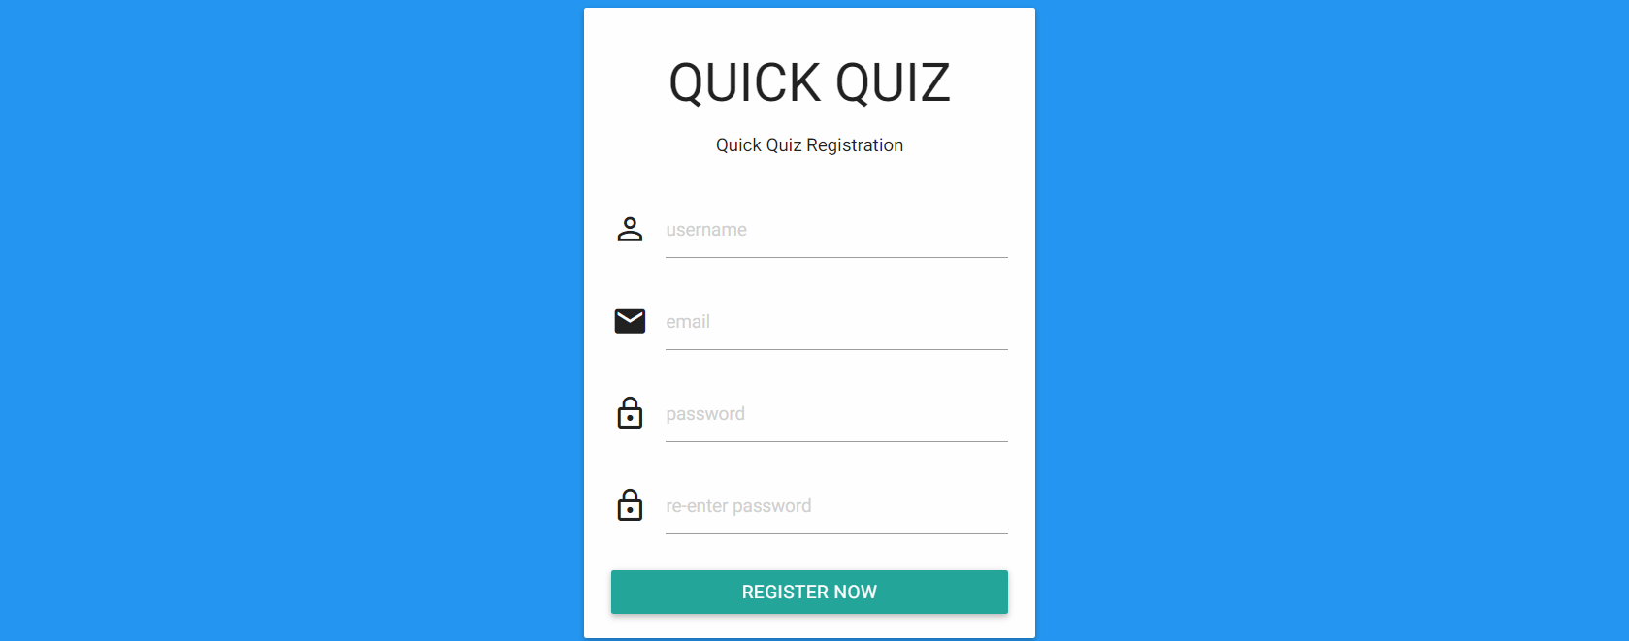
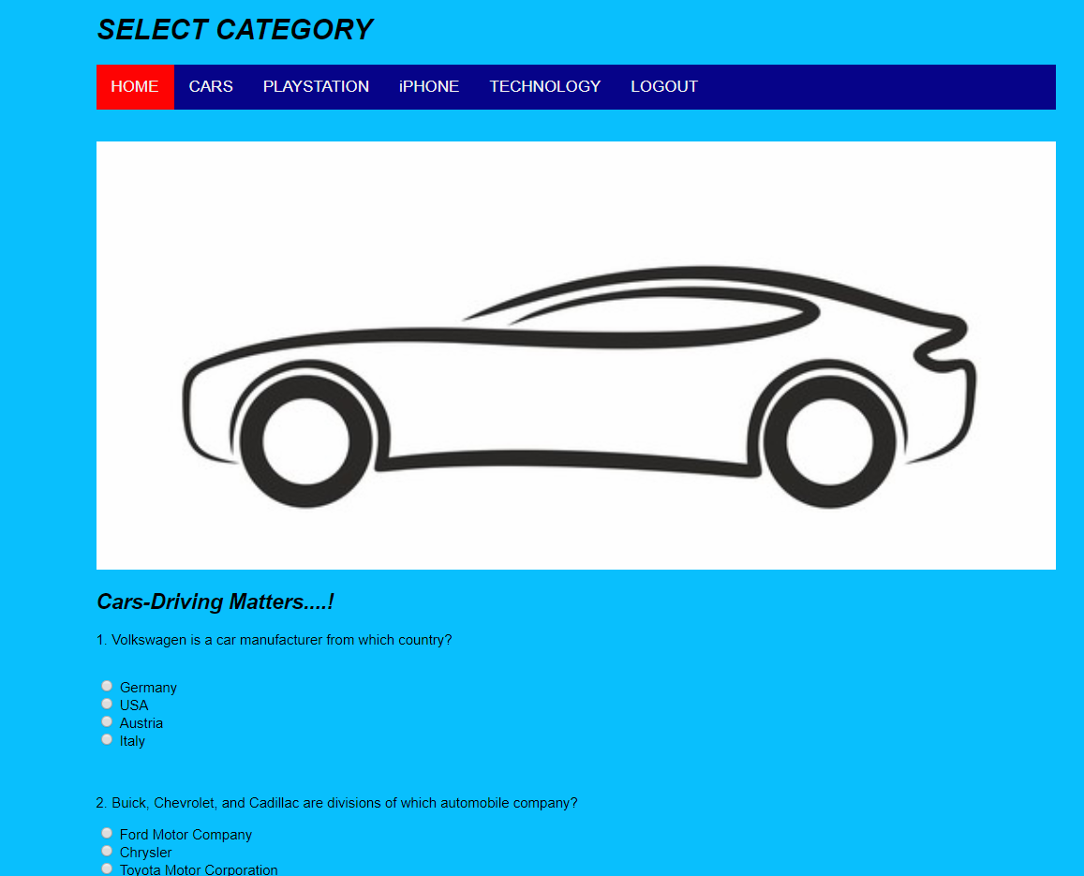
Working of the application
Register page
Quiz page

Slide 12
Strength
Easy to use
Attractive Design
Unique Questions
On-Spot results

Slide 13
Scope of improvement
More categories can be added.
Level of difficulty can be added in future
Getting Feedback from Users
Develop Mobile application once successful
Can be implemented online
Competing with Random opponents online

Slide 14
References
W3School, 2017. howto_js_topnav_responsive. [Online] Available at: https://www.w3schools.com/howto/howto_js_topnav_responsive.asp [Accessed 2017].
up, q., 2017. quiz up. [`Online] Available at: https://www.quizup.com/en [Accessed 11 2017].

Slide 15
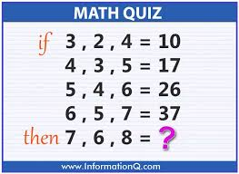
As this is a quiz application can you answer below one?

Slide 16
Thank you…

